Slide 1
Database Sync
Or whatever we want to name it

Slide 2
DBPublish: Current Method
Run times range:
97 minutes (weekly update only)
42 minutes (typical daily)
20 minutes (exception to the rule)
By the numbers:
459 total feature classes/views/tables publishing
Yearly: 52
Quarterly: 51
Monthly: 92
Weekly: 138
Daily: 17

Slide 3
DBPublish: Current Method
12+ Server Tasks
32 Configuration Files
24 Batch Files
13 Python Scripts

Slide 4
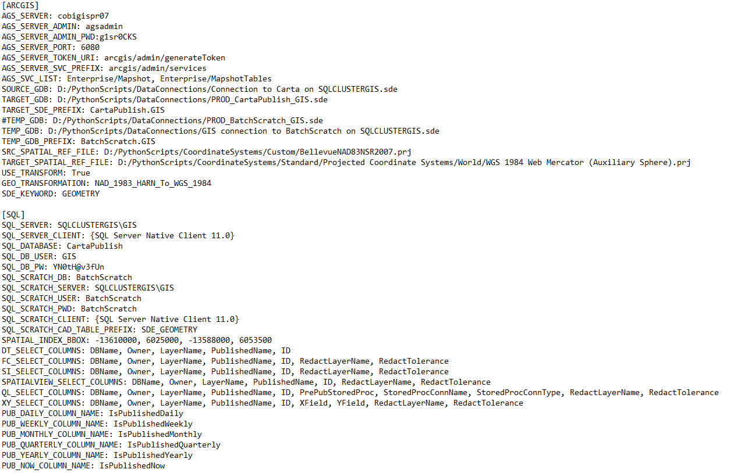
DbPublish: Current Method
Example CFG file (MapShot)

Slide 5
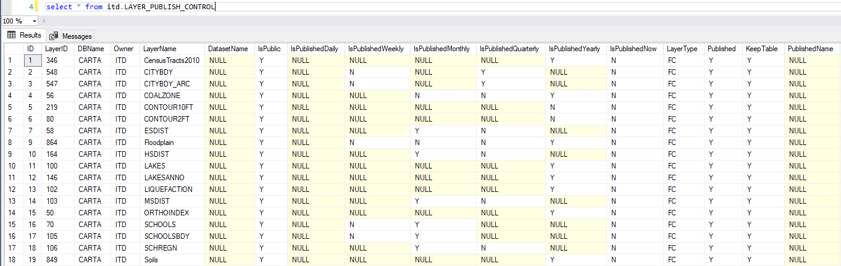
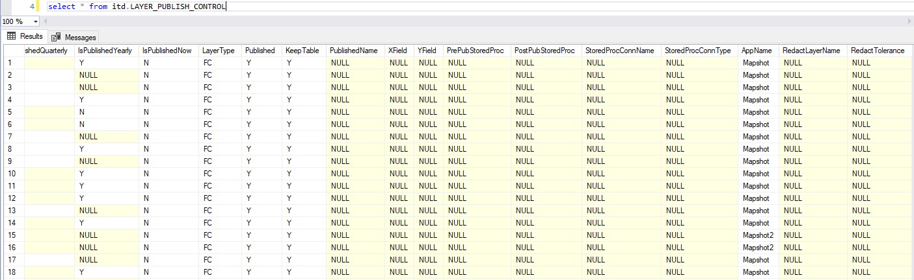
DbPublish: Current Method
Layer Publish Control table

Slide 6
Why Change?
Publishing regardless of actual need
Did it need to be updated?
Configuration heavy
XML configuration file
Dev focused Python setup
Relies on 3rd party Python libraries to execute basic functions
Potentially difficult to diagnose/repair
Updates 3 databases
Carta, PGISIIG, & WebMapping

Slide 7
How Our Data Really Changes
GIS Data Modification
First layer edited on 1/9/2017
Total Layers Published: 173
Total Days Publishing: 83
Average Publishes per day: 0.34
Users were editing 33% of the time between 1/9/2017 to 6/12/2018

Slide 8
Database Sync
Key design features:
Database centric
Publication Table
SDE Connection Table
View – Layers to Update
Requires 2 supporting views
1 Python script per publishing source database
No 3rd party library reliance
Publishes to multiple databases during single task
No view publishing required
Publish view source data and create view in target database

Slide 9
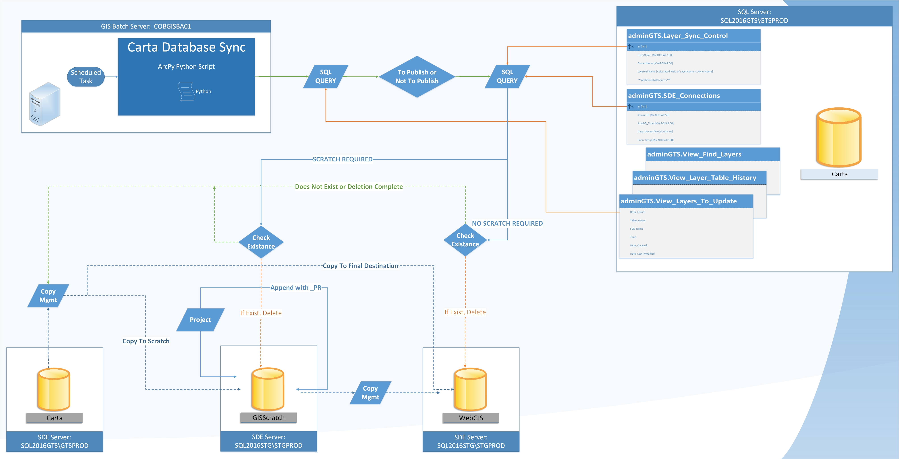
Database Sync

Slide 10
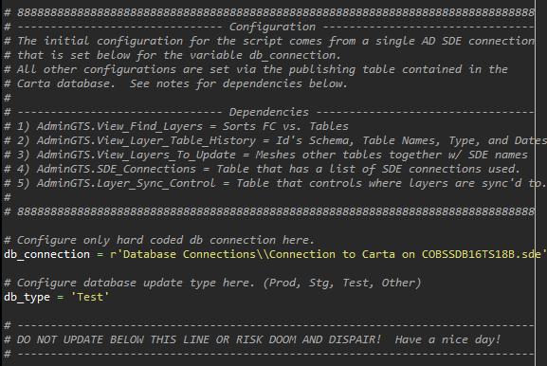
Database Sync
Only hard coded configurations
Data Link to read update table
Describes database type

Slide 11
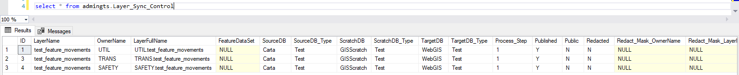
Database Sync
Layer Sync Control Table

Slide 12
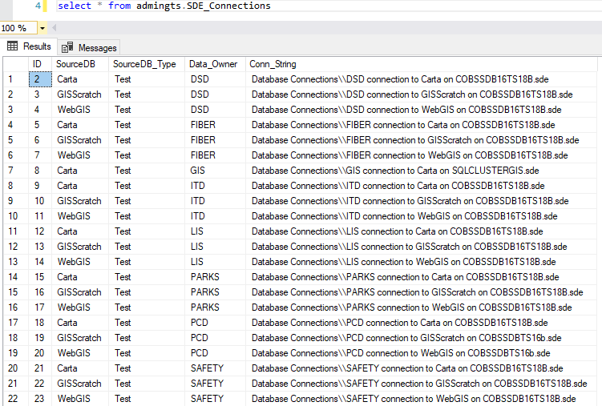
Database Sync
SDE Connections Table

Slide 13
Database Sync
Future Enhancements
Remote shut down/restart of AGS services at the OS level
Redaction
Database driven projections (choice)
Auto-add new features/tables to publication table
Defaults to not publish
E-mailed status updates (success/failures)
Non-SDE registered assets publishing
On-Demand publishing

